Slide 1
Insurance Customer Response Prediction
Yash Pandey

Slide 2
Table of Contents
Dataset Overview
Exploratory Data Analysis
Data Preprocessing
Model Selection
Model Training and Evaluation
Results and Interpretation
Conclusion

Slide 3
Dataset Overview
Introduction:
In this section we will analyze and accurately predict customer responses to insurance policy offers. By utilizing this model, the company aims to improve targeted marketing, optimize their sales channel strategy, and increase the efficiency of their policy sales process using a dataset containing 381109 rows and 12 columns.
Dataset Description:
The dataset contains several key features, including id, Gender, Age, Driving License, Region Code, Previously Insured, Vehicle Age, Vehicle Damage, Annual Premium, Policy Sales Channel, Vintage, and Response. The Response variable serves as the target, indicating whether a customer reacts positively to insurance policy offers. Our analysis will involve examining the dataset in detail—identifying the unique values for each feature and reviewing their data types—to gain a deeper understanding of the data and prepare it effectively for developing a machine learning model.
Source of Data is BIA Capstone Project.

Slide 4
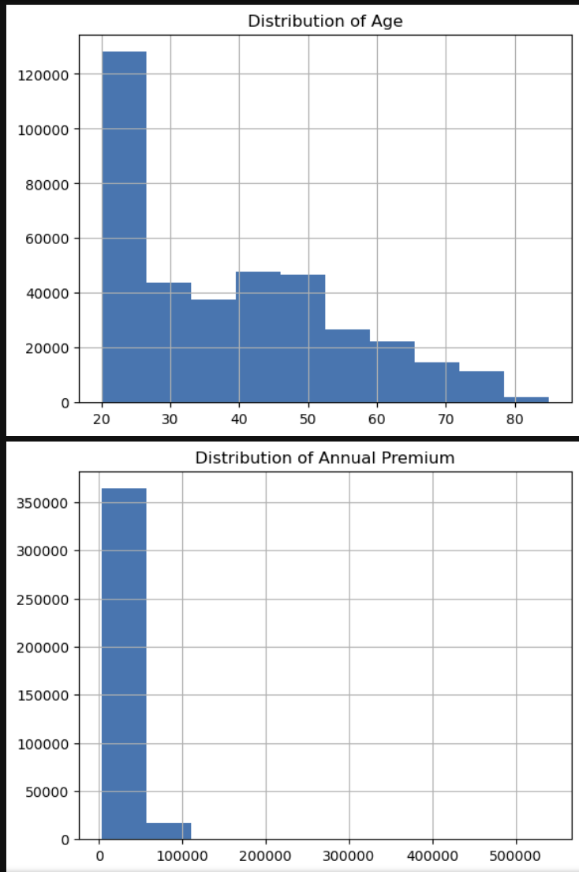
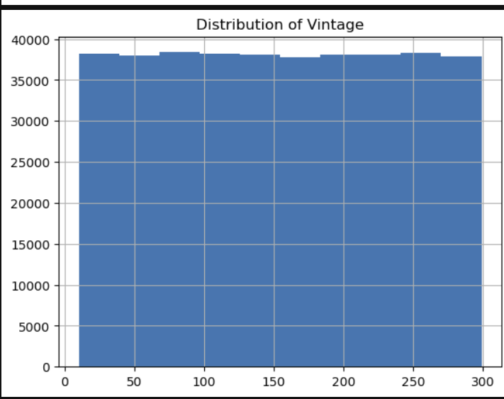
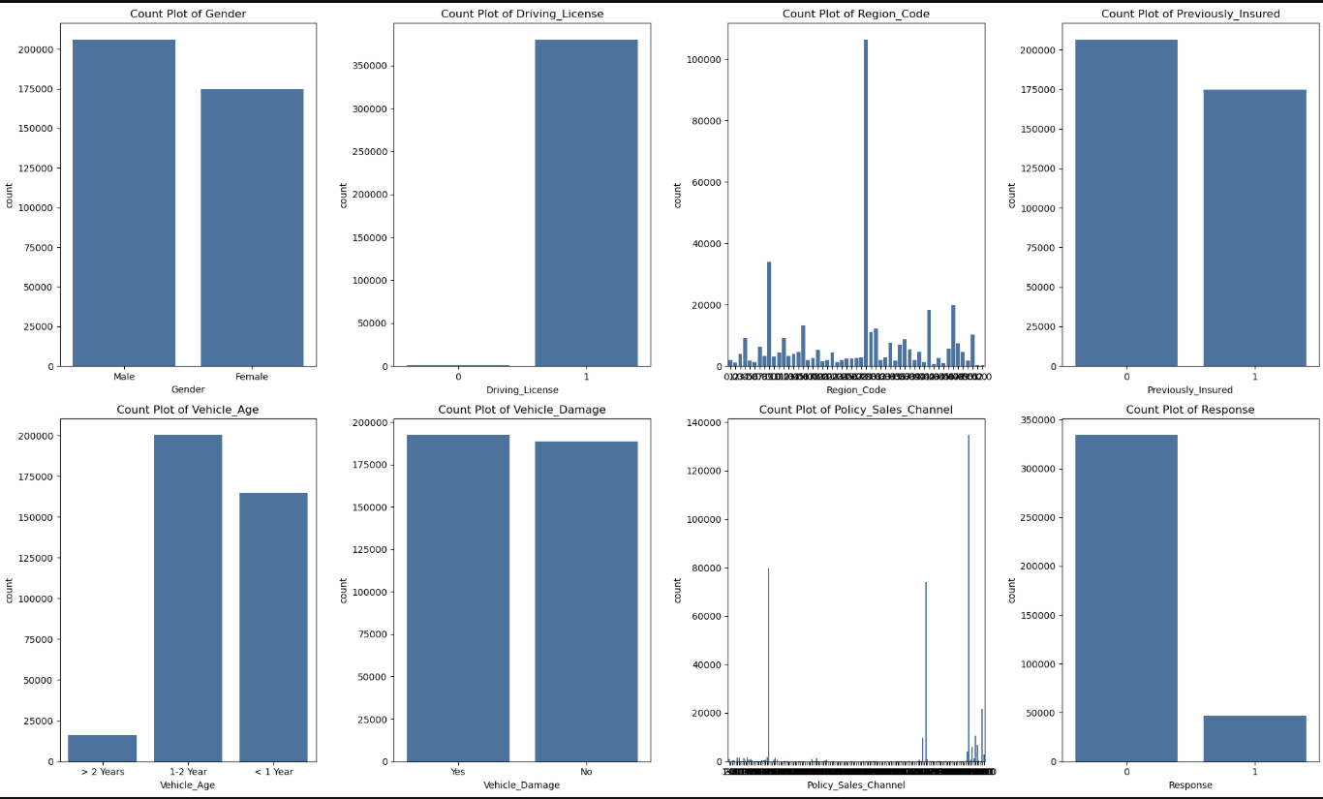
Exploratory Data Analysis
Analysis of dataset: The dataset contains 381109 rows and 12 columns.
Checking shape and missing values of data: Identifying missing value of data by using data.isnull() and also by plotting heatmap for the same
Visualizing the graph for numerical and categorical variables: Plotting graph for numerical variables such as Age,Annual Premium and Vintage and categorical variables such as Gender, Driving License, Region Code, Previously Insured, Vehicle Age, Vehicle Damage, Policy Sales Channel and Response

Slide 5
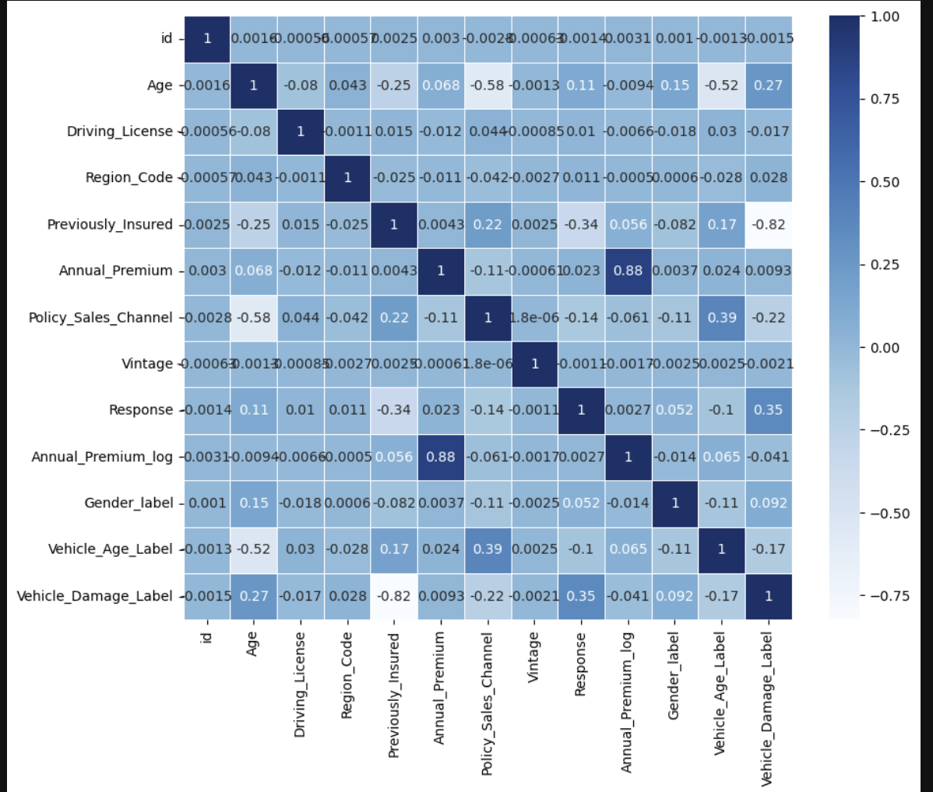
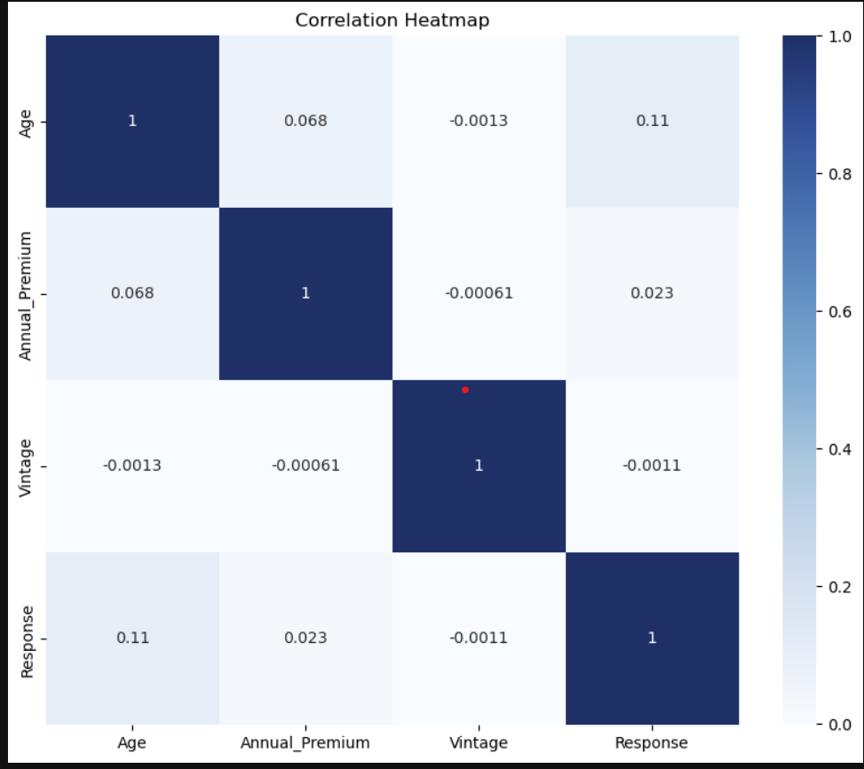
Exploratory Data Analysis
4. Correlation Heatmap of Numerical Variables and Categorical Variables: A correlation heatmap is a visual tool using colors to show the strength and direction of relationships between many variables in a dataset, where cells display correlation coefficients (from -1 to +1); typically, blue indicates strong positive correlation, light blue shows strong negative correlation.

Slide 6
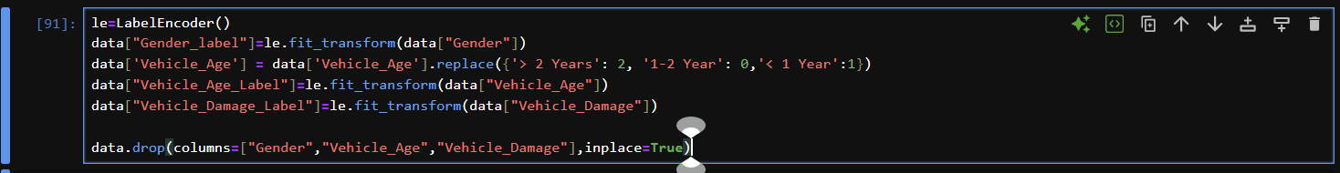
Data Preprocessing
Label Encoding: Label encoding is a data preprocessing technique in machine learning that converts categorical text data into numerical labels. In Vehicle Age we have implemented label encoding for > 2years, 1-2 years, <1 years is converted into numerical value which is 2,1,0
Checking shape and missing values of data: Identifying missing value of data by using data.isnull() and also by plotting heatmap for the same
Visualizing the graph for numerical and categorical variables: Plotting graph for numerical variables such as Age,Annual Premium and Vintage and categorical variables such as Gender, Driving License, Region Code, Previously Insured, Vehicle Age, Vehicle Damage, Policy Sales Channel and Response

Slide 7
Exploratory Data Analysis
4. Correlation Heatmap of Numerical Variables and Categorical Variables: A correlation heatmap is a visual tool using colors to show the strength and direction of relationships between many variables in a dataset, where cells display correlation coefficients (from -1 to +1); typically, blue indicates strong positive correlation, light blue shows strong negative correlation.

Slide 9
Title
Content

Slide 10
Questions ?

Slide 11
Thank You!

